Slide 1
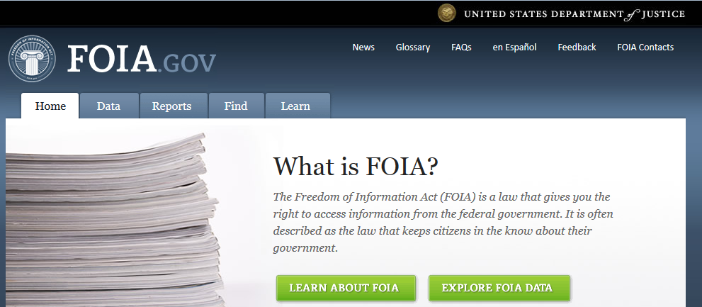
Non-Compliance Reporting and the Freedom of Information Act
ICARE Train-the-Trainers Institute
Group 4. Allyson Bennett, Robert Gibbens, William Greer, Swapna Mohan,
Christian Newcomer, Jerald Silverman

Slide 2
Understand what constitutes a reportable noncompliance event and identify the institution’s process for reporting noncompliance.
Understand why reporting and open records reflect a public mandate and how can provide either an accurate view or encourage public misconceptions
Understand how to write a noncompliance report and to whom it should be reported.
Notes:
[Note for facilitator that this is federal only, not state]

Slide 3
Understand what constitutes a reportable noncompliance event and identify the institution’s process for reporting noncompliance.
You will be able to:
Discriminate between reportable and non-reportable noncompliance events.
Explain how your institution reports noncompliance to internal stakeholders and to federal agencies.
Notes:
[Note for facilitator that this is federal only, not state]

Slide 4
Understand why reporting and open records reflect a public mandate and how can provide either an accurate view or encourage public misconceptions.
You will be able to:
Identify the purpose and use of FOIA.
Identify the potential consequences of FOIA release of noncompliance reports.
Notes:
PREVIOUS LANGUAGE
Understand why reporting and public transparency of reports reflects a public mandate for responsible balance of scientific objectives and consideration of animal welfare.

Slide 5
Understand how to write a noncompliance report and to whom it should be reported.
You will be able to:
Explain the ways in which noncompliance can be reported to a federal agency and who is responsible.
Understand the creation and use of an optimal noncompliance report.
Notes:
[Note for facilitator that this is federal only, not state]
PREVIOUS LANGUAGE
Understand why reporting and public transparency of reports reflects a public mandate for responsible balance of scientific objectives and consideration of animal welfare.

Slide 6
Understand how to write a noncompliance report and to whom it should be reported.
You will be able to:
Explain the ways in which noncompliance can be reported to a federal agency and who is responsible.
Understand the creation and use of an optimal noncompliance report.
Notes:
[Note for facilitator that this is federal only, not state]
PREVIOUS LANGUAGE
Understand why reporting and public transparency of reports reflects a public mandate for responsible balance of scientific objectives and consideration of animal welfare.

Slide 7
Congratulations!
You have written and submitted a perfect noncompliance report.
It complies with all federal regulation.

Slide 8
Federal agencies and you are not the only people who have an interest in your report.
Is your report good enough
to fulfill your obligation to the public?

Slide 9
What could go wrong?

Slide 10
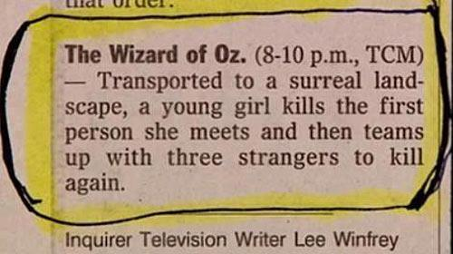
The Wizard of Oz – Transported to a surreal landscape, a young girl kills the first person she meets and then teams up with three strangers to kill again.

Slide 11
Scenario Part 1.
A new technician miscalculated a dose of experimental drug given to a USDA-covered animal in a PHS-funded study. The animal developed acute renal failure. The PI self-reports the incident to the IACUC.
Notes:
Facilitator

Slide 12
Scenario Part 1. A new technician miscalculated a dose of experimental drug given to a USDA-covered animal in a PHS-funded study. The animal developed acute renal failure. The PI self-reports the incident to the IACUC.
Your job as a group: Identify key elements that are required to be included in a report to federal agencies (5 minutes).
Report out key points that informed your report creation process.
Notes:
Facilitator Note:
Make a list of what the tables report out (10 min).
Make sure that the information below is covered either from table reports OR by facilitators.
Who is reporting and signing; what happened (category of personnel involved); what species; assurance number; grant number; PHS funded activity OR PHS-funded activity is affected by this incident; how many animals; animal deaths; plan and timeline for corrective action and prevention. Timeframe for report by institutional official.
If an animal activity is suspended, then USDA also needs to know. But not if a person is suspended.

Slide 13
Scenario Part 2.
An individual makes a FOIA request to OLAW for the noncompliance report. Upon receipt of the report, the individual alerts the media with a press release that is also posted on the internet via social media.
Notes:
FACILITATOR NOTE: Information that audience should generate and that should be included in the group report out for Scenario Part 2.

Slide 14
Public policy: Why do we have public records laws?
Representative government is dependent upon
an informed electorate.

Slide 15
Take your pick to imagine what might have happened……
Notes:
http://www.all-creatures.org/saen/media-20160610.html
Ex – OLAW report - http://www.all-creatures.org/saen/media-20160404.html

Slide 16
Scenario Part 2. An individual makes a FOIA request to OLAW for the noncompliance report. Upon receipt of the report, the individual alerts the media with a press release that is also posted via social media.
Your job as a group:
What additional content could you provide in the report that is not required but assists public understanding? (Table 1, 2, 3)
What content would you exclude because it is not required, not helpful, and potentially harmful?
(Table 5, 6)
Notes:
Examples that are required but assist public understanding.
The animal fully recovered.
A novel therapeutic agent being assessed for serious medical condition.
The animal was part of a study on a federally-funded project reviewed by scientific experts.
The animal’s care was reviewed and overseen by a committee that approves and oversees animal research studies.
Not required, not helpful, and potentially harmful
Names.
Building and room locations.
Research area, department.
Title of grant.
SOP numbers or text from SOP.
Adjectives.
Proprietary information (text from protocol, research strategy, experimental groups, controls)

Slide 17
Facilitator Notes
Not required but assists public understanding.
If an animal fully recovered, say so.
Concise statement that indicates a robust training program. Context provided is that there is a training program, trainers, mechanism for detecting error, and a mechanism for retraining to minimize risk occurrence.
Example language:
A novel therapeutic agent being assessed for serious medical condition.
The animal was part of a study on a federally-funded project reviewed by scientific experts.
The animal’s care was reviewed and overseen by a committee that approves and oversees animal research studies.
Not required, not helpful, and potentially harmful
Names
Building and room locations
Research area, department
Title of grant
SOP numbers or text from SOP.
Extraneous adjectives (festering, extremely, moribund)
Proprietary information (text from protocol, research strategy, experimental groups, controls)

Slide 18
You are now able to:
Explain the ways in which noncompliance can be reported to a federal agency and who is responsible.
Understand the creation and use of an optimal noncompliance report.

Slide 19
Summative Assessment Example
Create a flowchart that puts the following elements development and submission of a required report to OLAW or USDA. Cross out elements that should not be part of the process.
Call USDA / Call OLAW
Create an overly detailed description of event
File written report
Notify IACUC / Notify PI / Notify Public Affairs Officer
Create a concise and nonspecialist description of event
Include outcome for animal
Include grant number
Detail the institution’s steps to investigate
Describe the institution’s steps to minimize risk of re-occurrence
Notes:
LAST SLIDE

Slide 20
For Resources and More Information
NIH Guide Notice NOT-OD-05-034
PHS Policy Section IV.F.3
AWAR 2.31 (d)(7) “IACUC Suspension of an Activity”
The IACUC Handbook (Third Edition). Jerald Silverman, Mark A. Suckow, Sreekant Murthy, CRC Press (2014), Chapter 22. Marilyn Chimes, Priya Sancar.

Slide 21
Extra slides

Slide 22
GOAL 2) Understand why reporting and public transparency of reports reflects a public mandate for responsible balance of scientific objectives and consideration of animal welfare. [Note for facilitator that this is federal only, not state] Objective 2A: Identify the purpose of FOIA, the use of FOIA, and how it applies to noncompliance reports. Objective 2B: Identify how noncompliance reports are used and the potential consequences.
Summative ASSESSMENT:
T/F Noncompliance reports are often portrayed in media coverage as representative of typical animal care and treatment
Describe how three of the following could be consequences of a noncompliance report, with or without release of the report through FOIA:
Loss of funding
Closure of laboratory
Media coverage
Loss of donors
Institutional reputational damage
Loss of public confidence
Increased scrutiny
Fines
FORMATIVE ASSESSMENT:
Step 1. Each table generates a list of potential consequences of a noncompliance report.
Step 2. Each table reports out the top 3 potential consequences they identified.
Step 3. Create a consensogram.
Step 4. Discuss.

